Slide 1
SHiPS – Structured data as file system
Ravikanth Chaganti
@ravikanth

Slide 2
Agenda
Providers?
Introducing SHiPS
Writing a SHiPS Provider
PS Drive for bare metal system configuration validation
Questions?

Slide 3
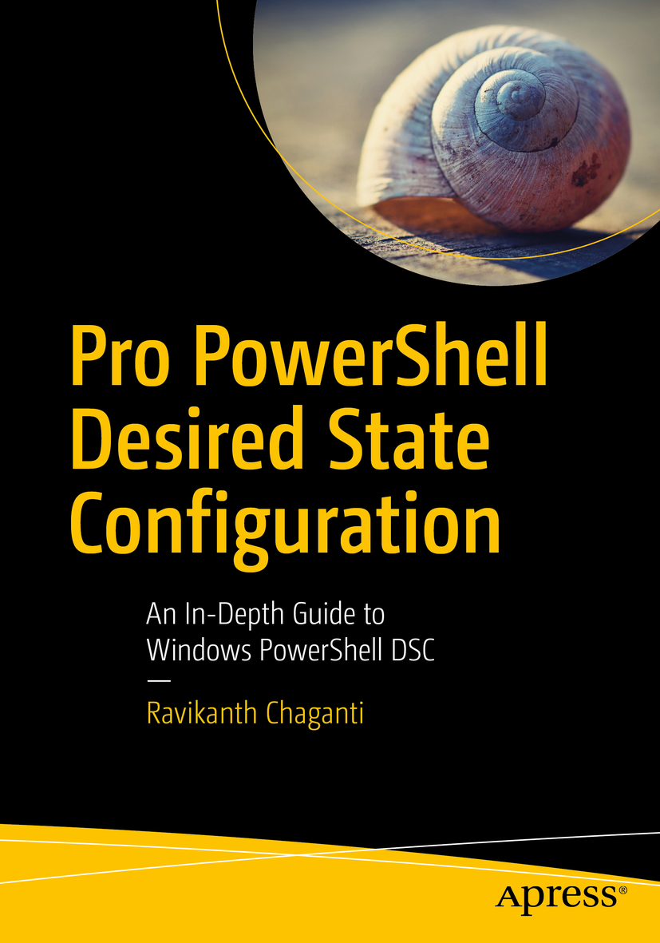
About Me
Work at Dell EMC as a Senior Principal Engineer.
Founder and Editor @ PowerShell Magazine.
Published Author
Windows PowerShell Desired State Configuration Revealed
Pro PowerShell Desired State Configuration
Multi-year recipient of Microsoft MVP award.
Automation Enthusiast!
Always learning!

Slide 4
Providers?
How many of you know and/or used PowerShell Providers?
How many of you have done this?
Set-Item -Path WSMan:\localhost\Client\TrustedHosts -Value *

Slide 5
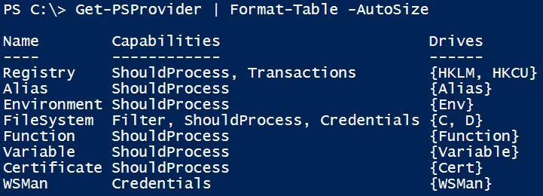
Providers?
Not a new concept! Existed since v1.
Provide a method to navigate and manipulate data from data stores through a common interface.
Not easy to develop a provider.

Slide 6
SHiPS – Simple Hierarchy in PowerShell
2014
2017
@beefarino created P2F
@powershell created SHiPS
@powershell created Azure PS Drive & CIM Drive
Thanks to @jianyunt for excellent work on SHiPS

Slide 7
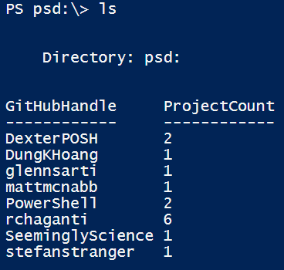
SHiPS – Simple Hierarchy in PowerShell
Writing new providers is easy!
Knowledge of PowerShell classes is needed.
Many examples in the community.

Slide 8
SHiPS – Get Started
Install-Module -Name SHiPS
Or Download from https://GitHub.com/PowerShell/SHiPS
Implements:
Get-Item
Get-ChildItem
No support yet for:
Get-ItemProperty
Set-Item
Set-ItemProperty

Slide 9
DEMO
PS Drive of PS Drives!

Slide 10
SHiPS – Writing a Provider
Requires
Knowledge of PowerShell classes!
Some level of structured data
Understand the data
Some thoughts on what / how you want to implement the provider
Let us look at EventLogDrive!

Slide 11
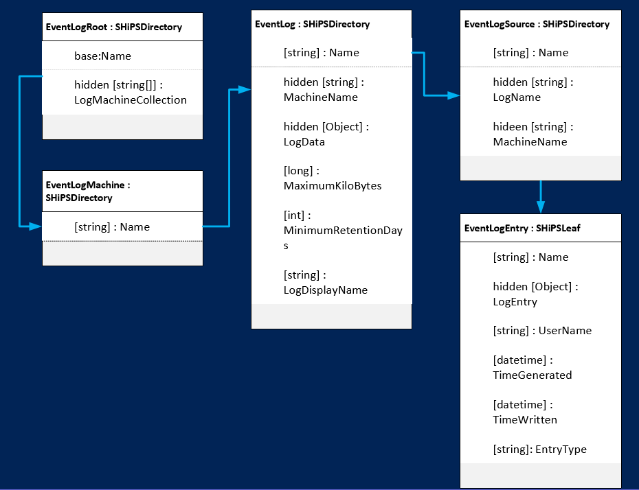
SHiPS – Writing a Provider

Slide 12
DEMO
EventLogDrive

Slide 13
Bare Metal System Configuration Validation
Enables browsing system configuration data as PS drive
Use cases:
Validate System Configuration against a reference configuration
Compare two systems for difference in attributes
When Set-* are available,
Batch set attributes on remote servers!
Upgrade / downgrade firmware!

Slide 14
Demo
Bare metal configuration drive

Slide 15
Summary
SHiPS makes it easy to implement PS drives.
Identify data source and understand it.
Identify use cases and start with design.

Slide 16
Questions?

